Slide 1
IMO STATE NYSC BATCH A , STREAM 2 ORIENTATION CAMP 2022
PREVALENCE OF DISEASE CONDITIONS AMONG CAMP MEMBERS.
BY
DR. VICTOR M. ADELEYE
(MB;BS ILORIN)
(CERT. DATA ANALYST)

Slide 2
PREFACE
Life in camp such as that of NYSC orientation camp can be so interesting and adventurous. Most of the times, the best can only be squeezed out of the experience when appropriate preparation and intentionality are in place.
Prior to mobilization for camp, I had been involved in rigorous training as a data analyst.
Enlightened more on the power of observation and essence of driving decisions using data, I prepared my mind to scrape the best out of every data I collide with.
The camp served as the opportunity for me. In camp, I was solely engrossed with the clinic activities especially when I was eventually elected as the Camp CMD.

Slide 3
PREFACE
Towards the end of the second week, we began to experience an observable increase in the burden of patient of patient with URTI.
Some of the clinic members were affected, myself included.
This triggered me to investigate within the limited resources available.
I extracted the data from the record of patient seen. My mobile phone, pen and paper became my companion as high tech gadgets such as laptops and the likes were not allowed in camps
The analysis here is majorly from excel. Subsequently, I plan to work on the data extracted using Power BI and Jupyter Notebook.

Slide 4
CAMP CLINIC PERSONNEL
DIETICIAN
RAPHAEL VICTORIA
OPTOMETRIST
OZIEGBE AKHERE
ANATOMIST
OMOTAYO OLUWAFEMI
MEDICAL LABORATORY SCIENTIST
EMMANUEL CLEMENTINA
PHARMACISTS:
OMOSIGHO GLORY
MOREBIE OLUWATIMLEHIN
ESSIEN INEMESIT
FAVOUR NDAKARA
BALOGUN PETER

Slide 5
CAMP CLINIC PERSONNEL
NURSES
HASSAN MUSA
OLANREWAJU HADIZAT
MEDICAL DOCTORS
ODOGU PRECIOUS
ALAO ABIGAIL
ABALLA VALENTINE
TOBY AGIOPU
IBRAHIM OBEL
ADELEYE VICTOR
CLINIC SUPERVISORS
DR. IKEDUM
MR. IFEANYI

Slide 6
OUTLINE
METADATA
COLUMN NAMING CONVENTION
NUMBER OF CASES
NUMBER OF DAYS
VISUALIZATION
CHARTS AND RELATIONSHIPS
INSIGHTS
OTHER OBSERVATIONS
RECOMMENDATIONS
CONCLUSION
APPRECIATION

Slide 7
METADATA
DATA SOURCE: Camp clinic record
SAMPLE– 981 cases seen over the period of time
TOTAL POPULATION OF CAMP MEMBERS: 1663 people
PERIOD CAPTURED BY ANALYSIS: 18th of March - 4th of April 2022
SWEARING IN DAY: 23rd of March 2022
LOCATION: Imo State NYSC Orientation Camp, Nkwerre, Imo Sta

Slide 8
COLUMN NAMING CONVENTIONS
URTI – Upper Respiratory Tract Infection which includes patients with signs and symptoms with Rhinitis, Rhinosinusitis, Pharyngitis among others
Malaria
Gastroenteritis – related – this include patient with acute gastroenteritis, diarrhea, dysentery symptoms and signs.
PUD – related – this include patient with symptoms and signs of Acute Gastritis, Peptic Ulcer Disease, GERD.
Body Pain: this includes patient with muscle cramps, sprain, joint pains from strenuous physical activities.
Others includes all other disease condition apart from above-listed

Slide 9
VISUALIZATION
Charts, relationships and insight

Slide 10
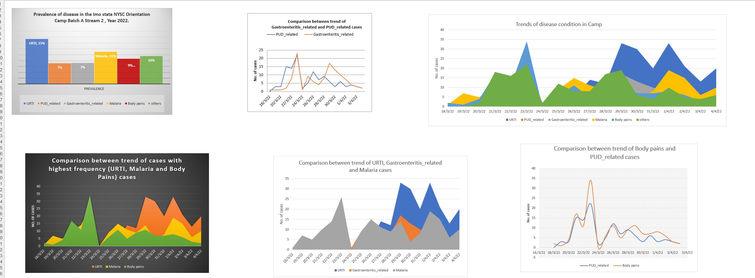
CHART SUMMARY

Slide 11
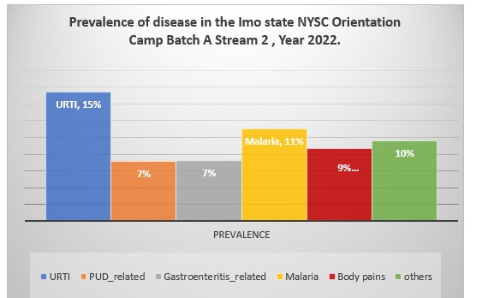
PREVALENCE
The histogram o the left shows the prevalence of common disease conditions in the camp among others.
the commonest disease condition rampant in the camp are URTI (15%) followed by Malaria (11%) and Body pains(9%).

Slide 12
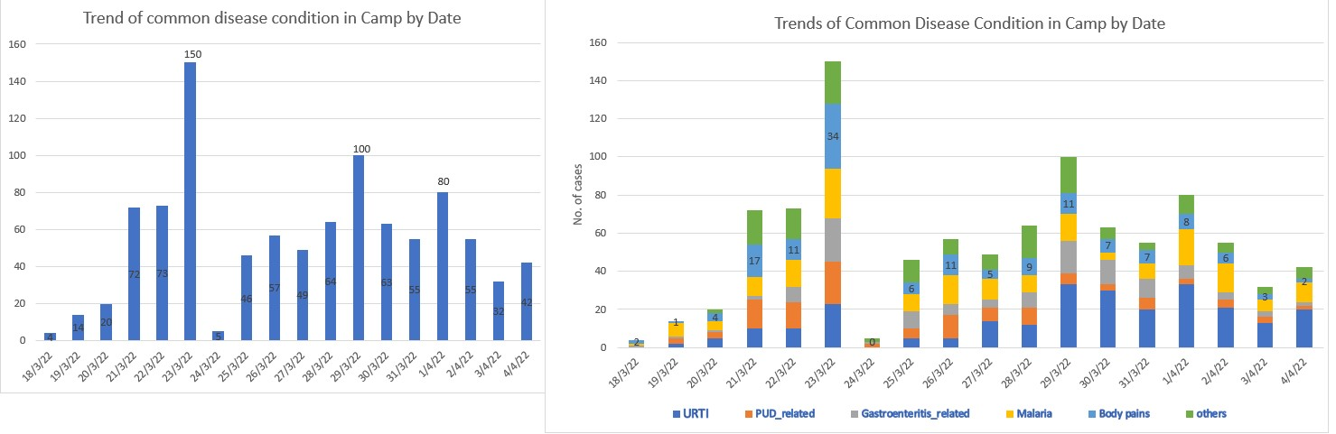
BURDEN OF COMMON DISEASE CONDITION IN CAMP PER DAY
RED ARROW: These are the days of highest burden of patient in clinic; March 23 ranking highest: the day of swearing in. We had 150 patients seen on that day as labelled in the column chart
BLACK ARROW: the days with lowest disease burden
COLUMN CHART
STACKED BAR CHART

Slide 13
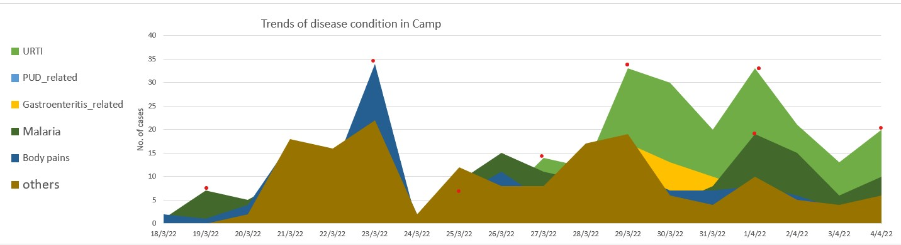
DISEASE BURDEN
The area chart shows initial prevalence of malaria above other conditions
However, as camp activities intensifies, there was a surge in the number of camp members visiting the clinic, with muscle cramps and joint pain ranking highest which peaked on the swearing in day(March 23)
URTI burden suddenly spiked above otherson March 27.
From thenceforth, URTI continued to maintain the momentum as the most prevalent disease condition till the end of the camp
D
B
A
C

Slide 14
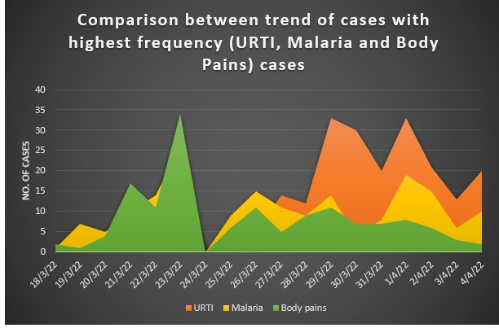
TREND OF THE MOST COMMON DISEASE

Slide 15
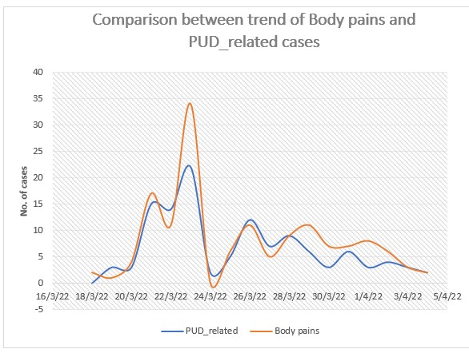
RELATIONSHIP BETWEEN BODY PAINS AND PUD_RELATED CONDITIONS
The line chart shows the correlation between PUD_related conditions and Body pains as they followed exact same trend.
They both spiked on the day of the swearing-in parade and dropped afterwards, then plateaued from 27th till the end.

Slide 16
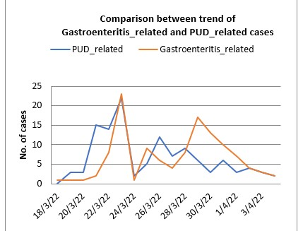
COMPARISON BETWEEN GI DISODERS

Slide 17
INSIGHT
The prevalence of upper respiratory tract infection was confirmed
The correlation between the PUD_related cases and Body pain in tandem with stressful physical activities undergone by camp members.
The increase in the number of cases per day on the swearing in day

Slide 18
OTHER OBSERVATIONS
There was more exposure to airborne particulates as camp activities (such as rehearsals for upcoming swearing in and the day itself) progresses.
There was also a change in weather condition (cold and rainy day) on the day that URTI spiked.
Communicable diseases easily spread due to unavoidable contacts during activities and in the lodge.
There was a usual spurt of patient frequenting clinic just before and after severe activities or intense drill or punishments.
Emergencies are highest during hours of physically demanding activities.

Slide 19
RECOMMENDATIONS
Epidemics of the common disease listed above in camps should be foreseen and prepared for by the health care providers.
Seasonal variation in the burden of disease will be helpful in supply of medications and equipment.
In the advent of suspicion of prevalence of certain disease condition, it should be reported to appropriate quarters for immediate intervention and prevention of further spread.
Camp clinic staff should always be at alert during rigorous camp activities such as parades, sports, and swearing-in days.

Slide 20
RECOMMENDATIONS
There is a need for careful monitoring, continuous evaluation and rapid response in case of urgency or emergency of epidemics.
Common diseases with their seasonal variation should also be anticipated.
Every hands must always be on deck and uninterrupted flow of information among the a head of administration, health care provider and camp clinic staffs.
Need for thorough documentation and record-keeping cannot be overemphasized as this will help in data-driven evaluation of management.

Slide 21
CONCLUSION
it was an eventful experience which helped me in deploying, learning and honing more skills for healthcare leadership and the essence of data collection, data crunching and research.
I also had first-hand experience of the dynamicity of Healthcare management in camp settings. The need for careful monitoring, continuous evaluation and rapid response in case of epidemics or emergencies.
In addition, the efficiency produced working with loving, intelligent, intentional, compassionate and zealous team members.

Slide 22
APPRECIATION
First and above all, Blessed be God almighty who gave me life through His breath, ever faithful in protecting and providing for His own. He is Omniscient, in Him all knowledge is found.
Appreciation goes to the Imo state camp coordinator(), Camp welfare coordinator, Camp clinic manager, our Supervising Resident Doctor from FMC, Owerri, the NHIS State coordinator,
and my wonderful and loving Imo state NYSC Batch A, Stream 2 Orientation camp clinic family.

